Slide 1
Presenter notes
The slides below are to provide instructions for the user. They can all be deleted when you’ve completed your presentation.
To view slide options, click the “New Slide” button at the top. While this will give you the general look and feel, feel free to make it your own.
Remember PowerPoint is a visual medium like television. People will better remember images and headlines than text-heavy slides.
Don’t use the “Design Ideas” button – suggestions are not always brand compliant.
Find NDDOT on the ND Media Library.
If you have questions, or would like guidance, please email Nicole at nipeske@nd.gov.

Slide 2
Logos
Please follow brand guidelines for placement of the logo.
The logos on this slide are all saved at .PNGs so they have no background – you can copy and use them per the brand guidelines.
To size the logo, drag from the corner of the box to ensure the logo stays proportional.

Slide 3
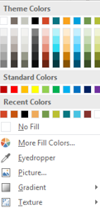
Slide palette info
The PowerPoint palette for this template has been built for you and is shown below. Avoid using too many colors in your presentation.
Accent colors 1-6 – (6 Theme Colors to the far right)
Text
Dark 2
Accent 1
Accent 2
Accent 3
Accent 4
Accent 5
Accent 6
Use Accents 4-6 sparingly – only when more colors are necessary.
Use Accent 1 as the main accent color on light background. Use Accent 2 for subhead text or as an accent color on dark grey background. Use Accent 3 when additional colors are needed.
Note – white type on darker backgrounds, but black on the gold for best readability.

Slide 4
Paragraph title Segoe UI Regular 14
Body copy Segoe Regular 14/10.5
Paragraph title Segoe UI Regular 14
Body copy Segoe Regular 14/10.5
Paragraph title Segoe UI Regular 14
Body copy Segoe Regular 14/10.5

Slide 5
Three column photo layout
Paragraph title Segoe UI bold 18/14
Highlights and/or key points
Short sentence and/or “bullet” points here.
Body copy use the font Segoe Regular 10.5pt
Paragraph title Segoe UI bold 18/14
Highlights and/or key points
Short sentence and/or “bullet” points here.
Body copy use the font Segoe Regular 10.5pt
Paragraph title Segoe UI bold 18/14
Highlights and/or key points
Short sentence and/or “bullet” points here.
Body copy use the font Segoe Regular 10.5pt

Slide 6
Three column photo layout
Paragraph title Segoe UI bold 18/14
Highlights and/or key points
Short sentence and/or “bullet” points here.
Body copy use the font Segoe Regular 10.5pt
Paragraph title Segoe UI bold 18/14
Highlights and/or key points
Short sentence and/or “bullet” points here.
Body copy use the font Segoe Regular 10.5pt
Paragraph title Segoe UI bold 18/14
Highlights and/or key points
Short sentence and/or “bullet” points here.
Body copy use the font Segoe Regular 10.5pt

Slide 7
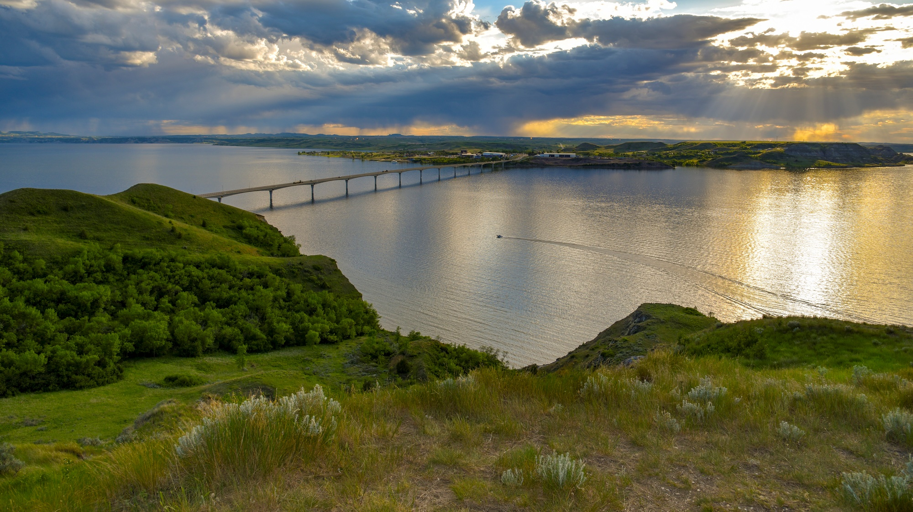
ANOTHER OPTION
IMPORTANT THING 1 | IMPORTANT THING 2 | IMPORTANT THING 3

Slide 8
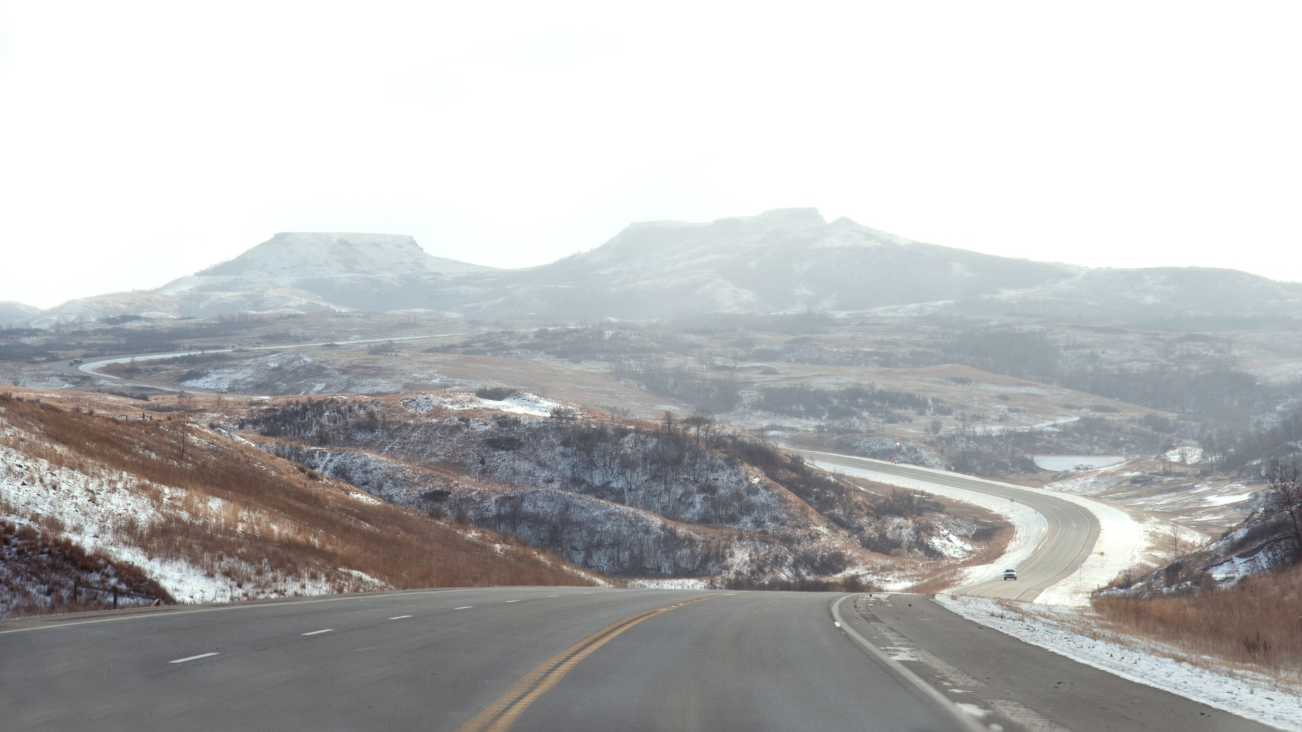
HEADER HERE

Slide 9
Text here

Slide 10
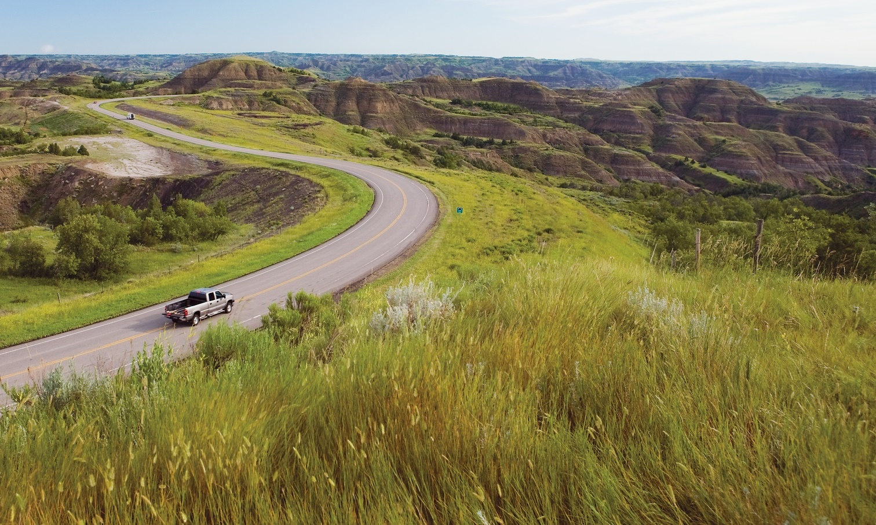
INFRASTRUCTURE FUNDING
QUESTIONS?
Bill Panos, Director

