Slide 1
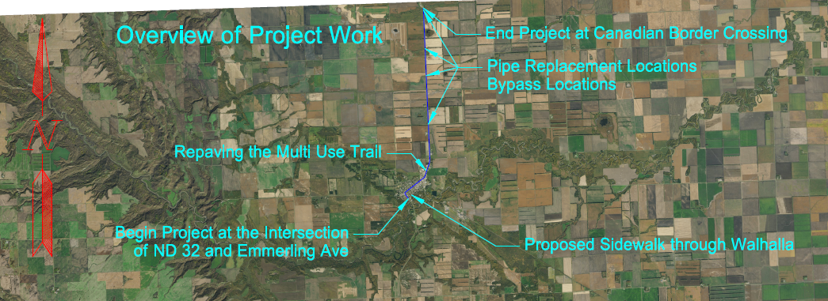
Highway 32 Construction Project

Slide 2
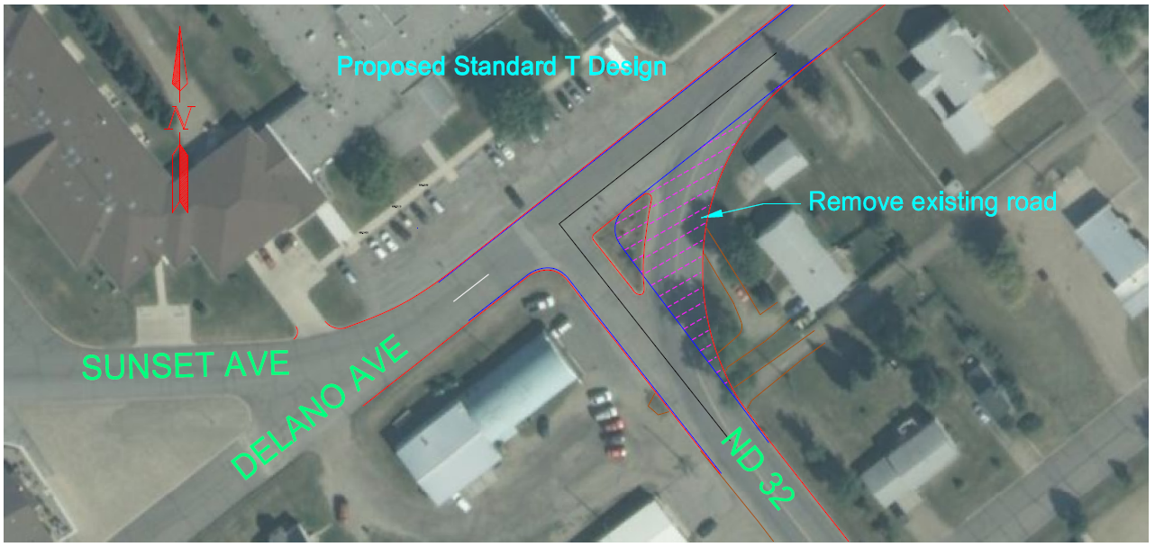
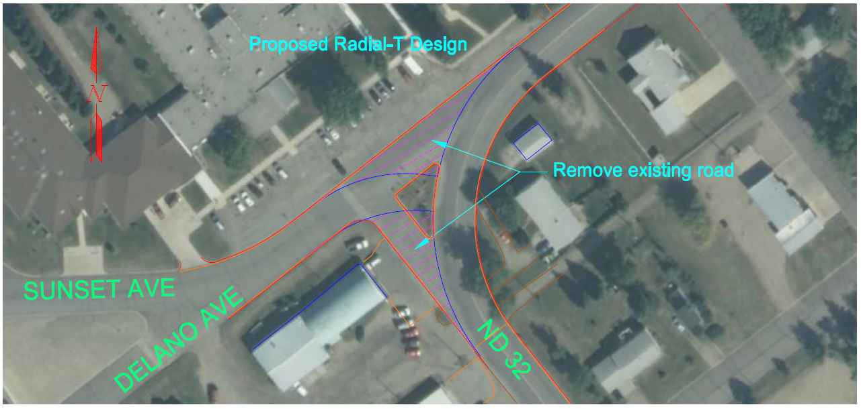
The Intersection of ND 32 and Delano Ave will NOT have the redesign done that was discussed at the Public Input Meeting in 2022.

Slide 3
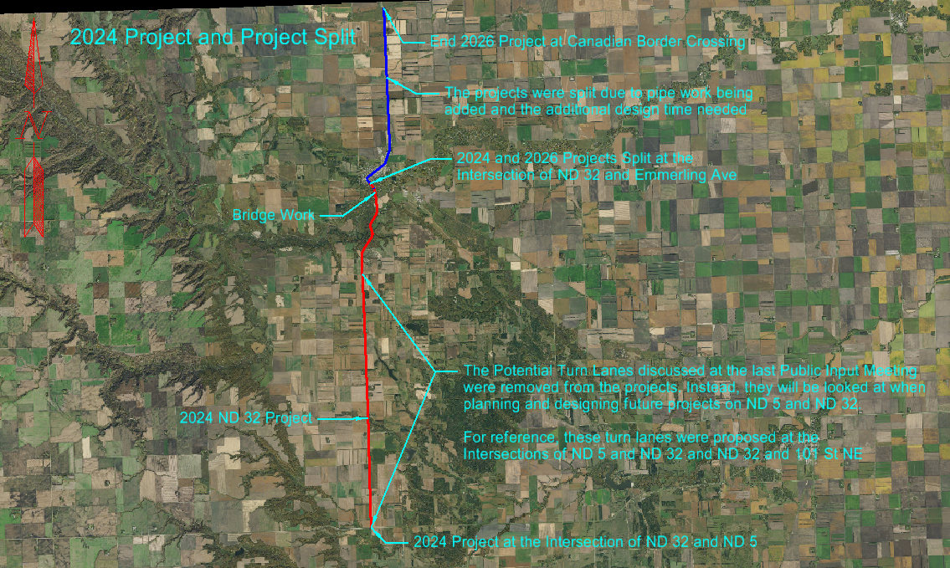
Splitting the 2024 Project.
Why and Where

Slide 4
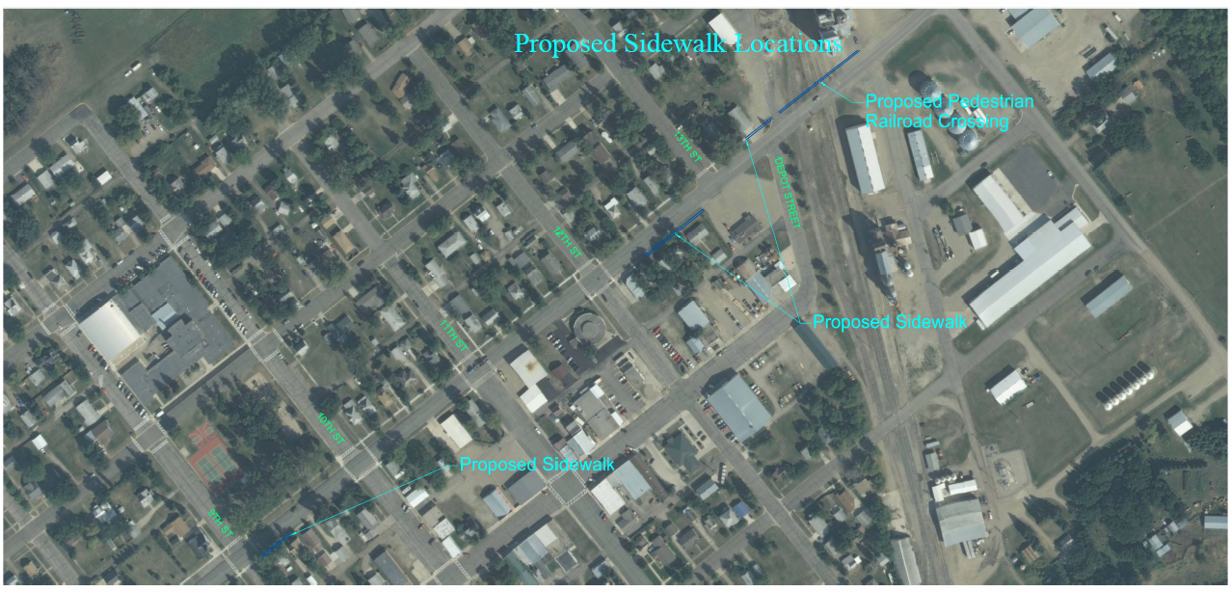
Proposed Sidewalk – North

Slide 5
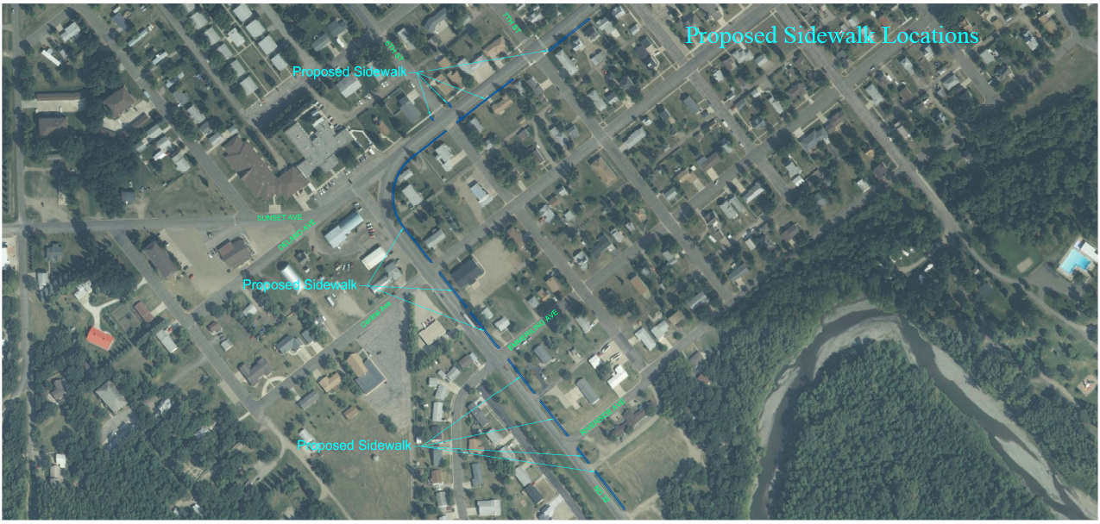
Proposed Sidewalk – South

Slide 6
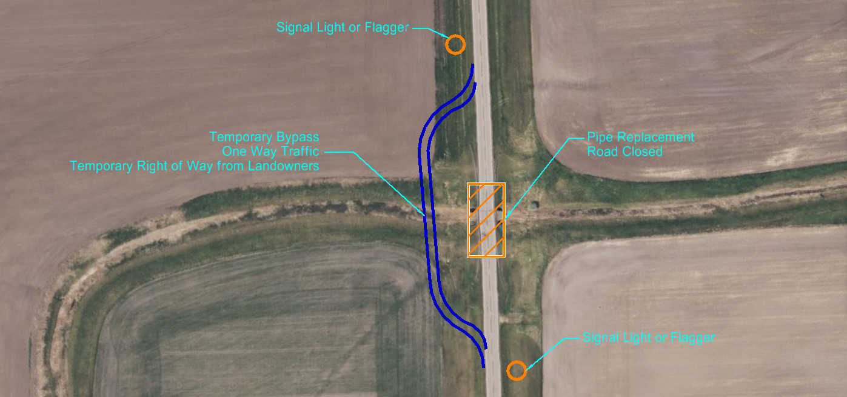
Pipe Work and Temporary Bypasses

Slide 7
Final Comments

